Slide 1

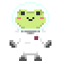
Project b

Slide 2
Wat wij al hebben gedaan
The main protagonist
The story line
The gameplay
Basis code
Trello
One-Page

Slide 3
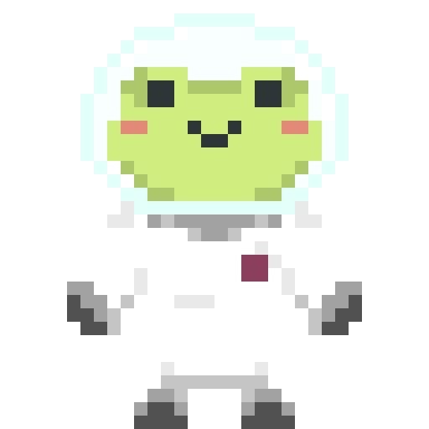
Meet Agent f
This little guy is an astronaut who’s ship crashed. You will be playing as him and help him with “Project B”. Project B, also known als Project Back Home entails collecting parts of his ship so he can fix his ship and go back to his home planet. The problem? They’re all scattered around multiple planets with unknown entities. Collect them all and send agent F home.

Slide 4
Gameplay?
2D
Platformer
Dash
(Dubble) jump
Enemies

Slide 5
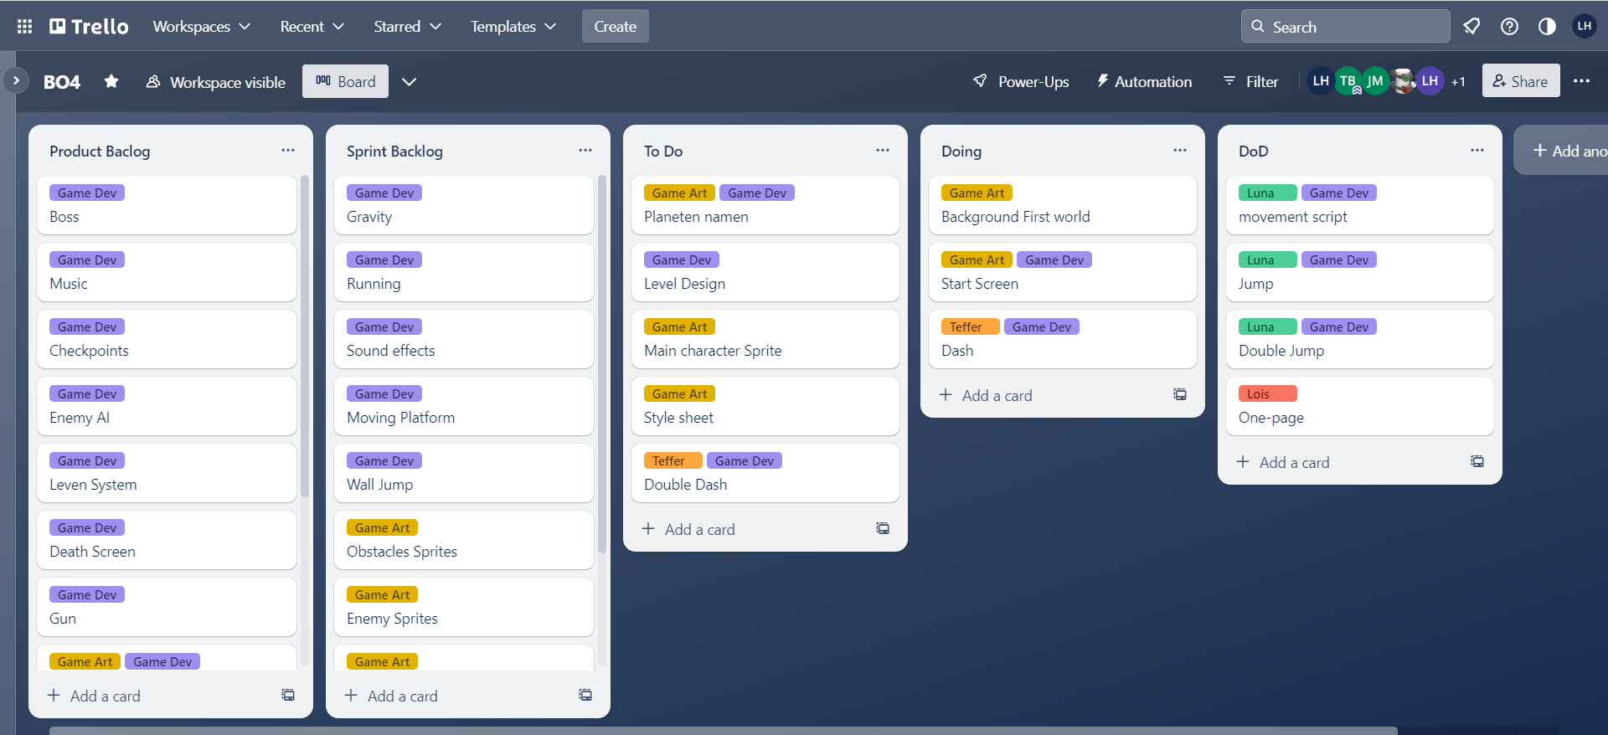
Trello

Slide 6
One-page

Slide 7
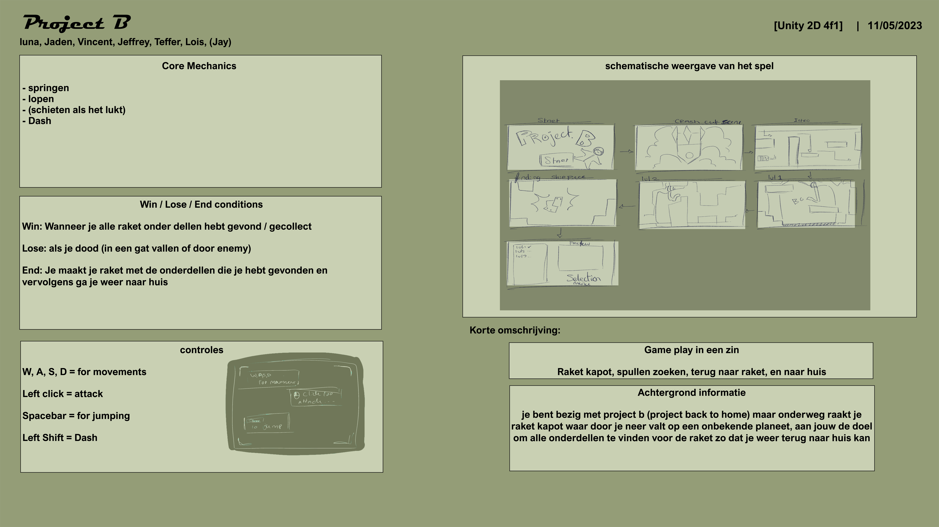

Slide 8
Project b
Jaden
Lois
Vincent
Jeffrey
Luna
Teffer
(Jay)

